Slide 1
LinkWise: A RAG-Based Digital Safety Guidance Chatbot for Assessing Unfamiliar URLs Among Students in Secondary and Higher Education
Presented by: ByteGuard
Balneg, Maria Cristina
Bartolome, Beatrice Matilda
Sayat, Lyona Yvonne

Slide 2

Overview
01
Background of Study
02
SDG Alignment
03
Key Problem
04
Research Question
04
Initial Data Sources
05
Proposed Language Model
06
References

Slide 3

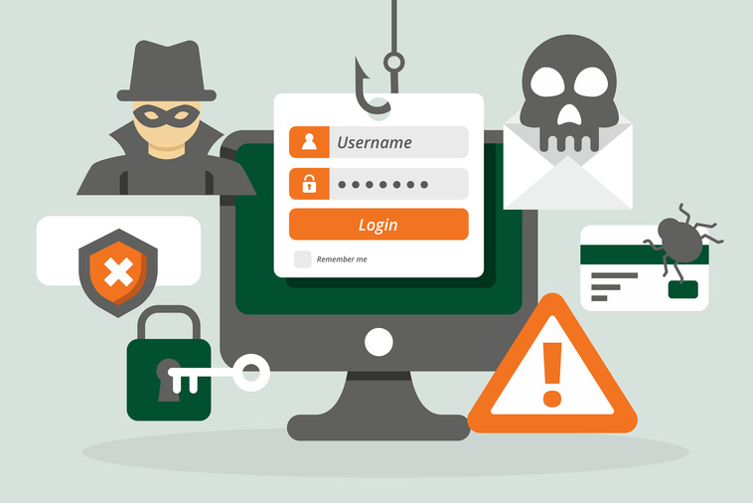

Background of the Study
LinkWise is a Retrieval-Augmented Generation (RAG) chatbot designed to provide digital-safety guidance to students who encounter unfamiliar or suspicious URLs. It retrieves information from trusted cybersecurity and privacy documents and uses this information to generate clear and helpful responses. The study focuses on providing guidance and education rather than automatically detecting whether a URL is malicious. The project is also connected to SDG 4: Quality Education, particularly in promoting practical digital literacy and safe use of technology.

Slide 4

WHY IS THE SELECTED SDG RELEVANT?
The study is connected to Sustainable Development Goal 4: Quality Education, particularly SDG Target 4.4, which includes information and communication technology (ICT) skills as an important skill area for young people and adults. Since students regularly use messaging apps, social media, email, and online learning platforms, they need practical digital-safety skills to use these technologies safely and responsibly. The study supports SDG 4 by helping students better understand unfamiliar or suspicious URLs and make safer decisions when using digital platforms.

Slide 5
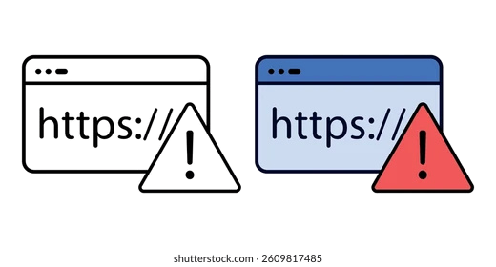
KEY PROBLEM
  Recognizing warning signs in unfamiliar URLs
  Safety actions to take
Unfamiliar URLs may be encountered through:
  Messaging apps
  Social Media
  Email
  Online learning platforms
Notes:
Problem to be addressed

Slide 6

RESEARCH QUESTION
To what extent can a RAG-based chatbot provide more correct and well-supported digital-safety guidance for students in secondary and higher education who encounter unfamiliar URLs compared with a chatbot without RAG?

Slide 7


INITIAL DATA SOURCES
Initial knowledge-base data will come from trusted cybersecurity and privacy documents, including guidance from the National Privacy Commission (NPC) and Federal Trade Commission (FTC)

Slide 8
PROPOSED LANGUAGE MODEL
131,072 - token context window
Supports text input and output
Processes retrieved passages with the student's question
Provides clear, document-grounded digital-safety guidance
The proposed language model is GPT-OSS 20B through Groq. It has a 131,072-token context window, making it a practical option for processing retrieved passages together with a user’s question in a student RAG experiment.
Can indicate when information is insufficient

Slide 9
REFERENCES
[1] United Nations Department of Economic and Social Affairs, “Goal 4: Quality Education,” Sustainable Development Goals.
[2] National Privacy Commission, “NPC PHE Bulletin No. 21: Preventive Data Privacy Practices Against Smishing,” 2021, updated 2022.
[3] National Privacy Commission, “Threats to Security and Privacy,” 2017, updated 2022.
[4] Federal Trade Commission, “How To Recognize and Avoid Phishing Scams,” Consumer Advice, 2022.
[5] Groq, “GPT OSS 20B,” GroqDocs, accessed September 16, 2026.

Slide 10
THANK YOU

